Slide 1
Fashion segmentation
Segmentation of fashion-related items

Slide 2
Agenda
Project overview
Segmentation Architectures
- Structure
- Pros and Cons
- Train process and time
- Results/Examples
Alternative Applications
Conclusions
Guidelines:
20 min + 5-10 mins for questions
Clear explanation of method or algorithm
Illustrative results
Text size 16+; large enough to read

Slide 3

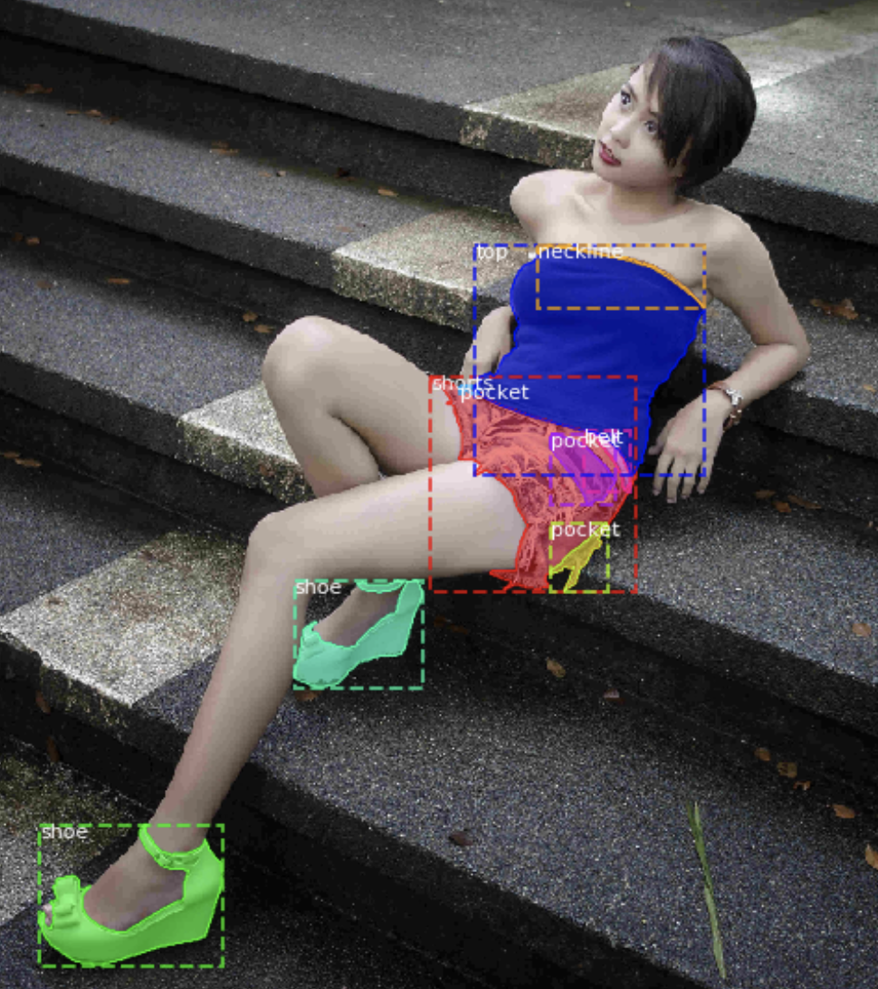
Fashion Segmentation
Objective
Segment fashion-related items
Mask-RCNN is logical choice

Slide 4
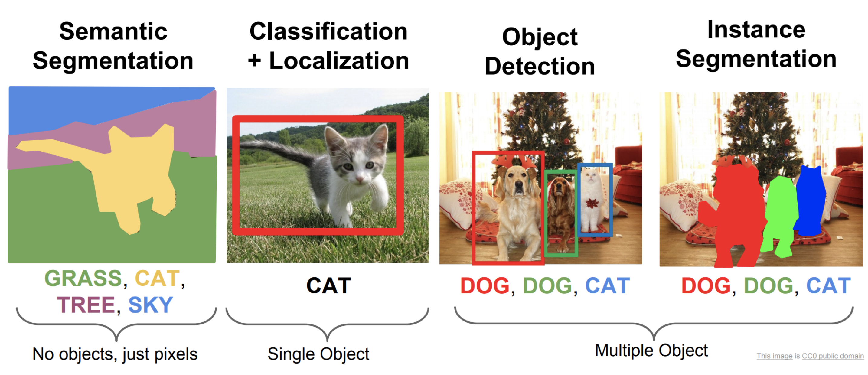
Segmentation and Classification
Alternative segmentation outputs
Different architectures produce different output.
The desired output will drive the selected architecture.

Slide 5

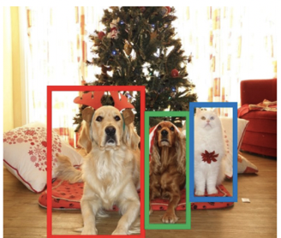
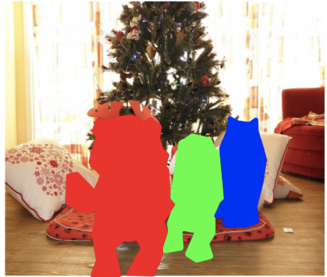
Selection of Architecture
Object Detection Architectures
Semantic
Segmentation
Object
Detection
Instance
Segmentation
Architecture | Description
DeepMask | Early segmentation architecture (9/2015) |  | X | X
SharpMask | Refinement of DeepMask (7/2016) |  | X | X
Faster R-CNN | Evolution of R-CNN network |  | X
Mask R-CNN | Includes bounding boxes along with instance segmentation |  | X | X
Yolact | Real-time speeds |  | X | X

Slide 6
Instance Segmentation- Evolution
Mask R-CNN
Adds Instance Segmentation
3 outputs:
Classification
Bounding Box
Instance Segmentation
(near real-time 5fps)
https://arxiv.org/pdf/1703.06870.pdf
Object Detection Frameworks
Fast R-CNN
Single network for features, classification and bounding boxes
https://arxiv.org/pdf/1504.08083.pdf
Faster R-CNN
Added Region Proposal Network
(near real-time 5fps)
https://arxiv.org/pdf/1506.01497.pdf
R-CNN
Introduced concept of region proposals
https://arxiv.org/pdf/1311.2524.pdf
YOLACT
Real-time segmentation
(real-time 30fps)
https://arxiv.org/pdf/1904.02689.pdf
2014
2015
2016
2017
2018
2019
DeepMask
https://arxiv.org/pdf/1506.06204.pdf
SharpMask (.8FPS)
https://arxiv.org/pdf/1603.08695.pdf
https://blog.athelas.com/a-brief-history-of-cnns-in-image-segmentation-from-r-cnn-to-mask-r-cnn-34ea83205de4

Slide 7
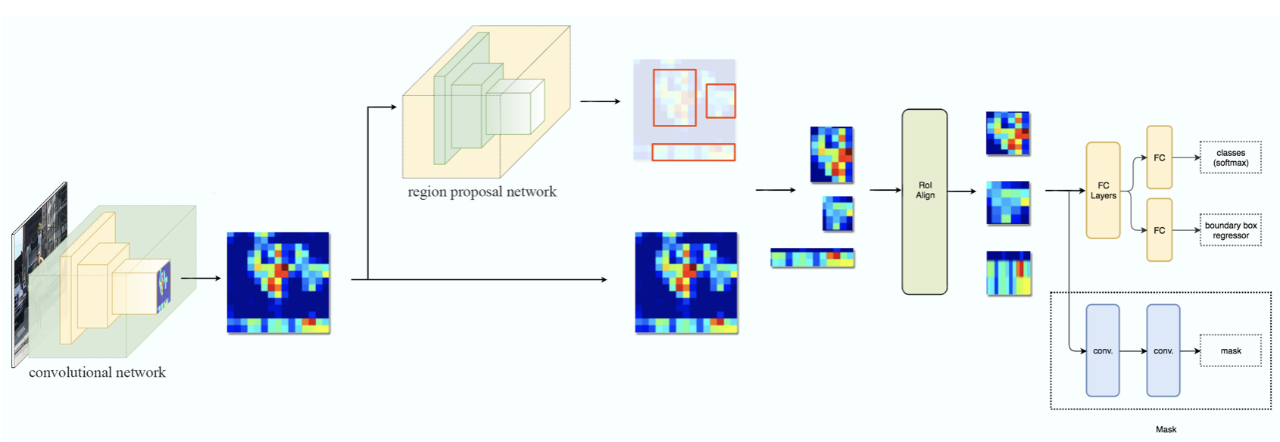
A Closer Look at Mask R-CNN
Faster R-CNN
Object Detection Branch
Segmentation Branch
Mask R-CNN
Faster R-CNN
- Outputs classification with bounding boxes
Mask R-CNN
Adds segmentation
Introduces Regions of Interest

Slide 8

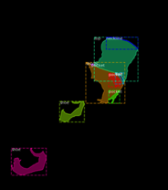
Mask R-CNN – Backbone/Encoder (convolutional base)
Faster R-CNN
Object Detection Branch
Convolutional Network
Pyramid Structure
Segmentation Branch
Mask R-CNN
Backbone/Encoder:
Captures shape information and drops fine-details
Pyramid-like structure
Skip Connections
`
Encoding
FashionDataSet uses ResNet50 as backbone

Slide 9
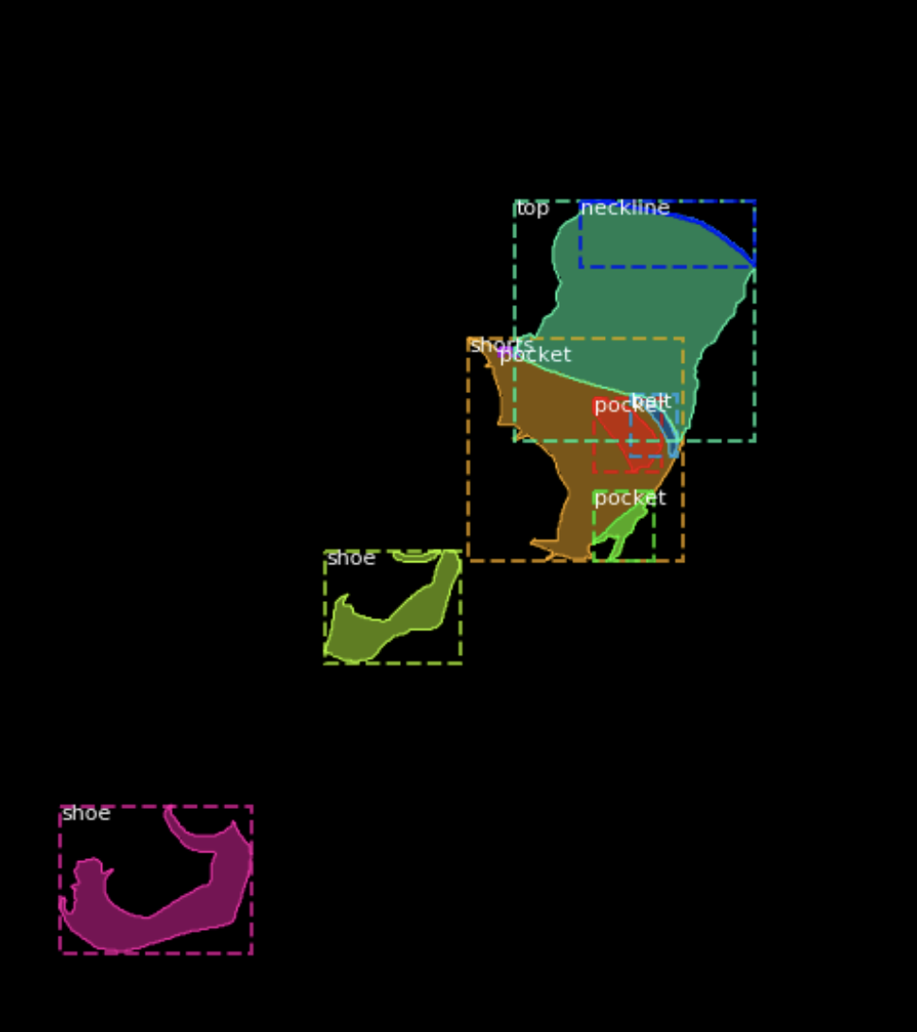
Pyramid Structure
Encoder
The encoder translates image into shapes sacrificing surface details
Decoder
The decoder translates the encoded shapes into a viewable image
Each layer of pyramid changes dimensions that capture features of different sizes
Encoder shares shape information at different scales to improve masking of objects with varying sizes
Encoding
`

Slide 10
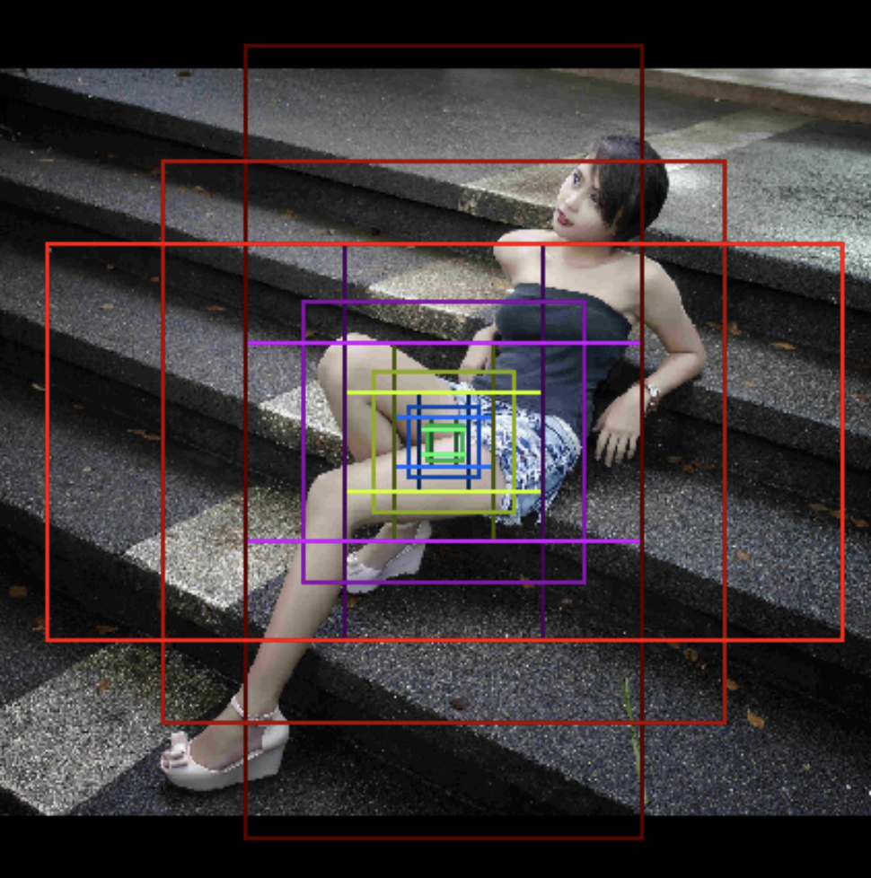
Mask R-CNN – RPN – Region Proposal Network
FashionDataSet
262k regions per image
5 sizes and 3 aspect ratios
Faster R-CNN
Object Detection Branch
Segmentation Branch
Mask R-CNN
Region Proposals:
Faster R-CNN contribution
Defines possible bounding boxes
Regions proposed at each pyramid level
Various aspect ratios and sizes

Slide 11
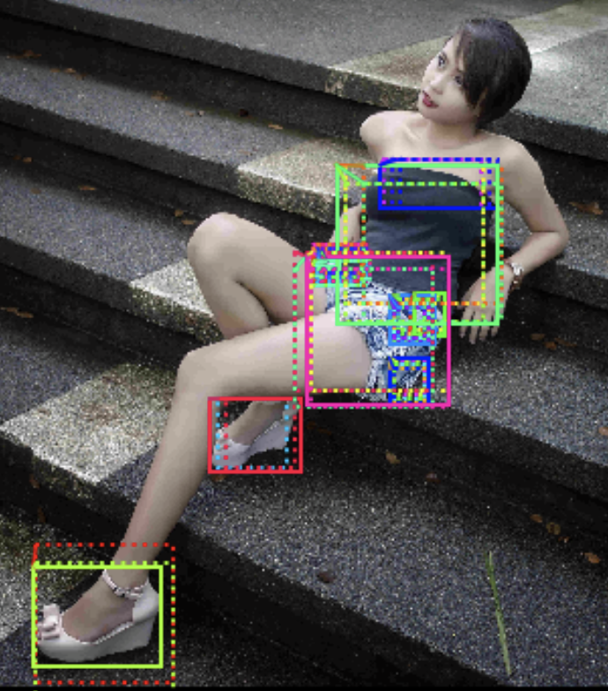
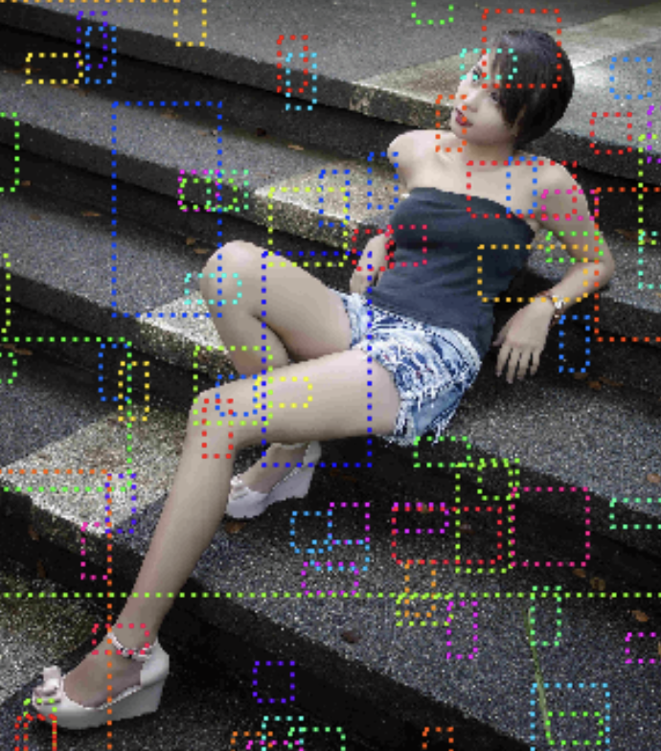
Mask R-CNN – Region Proposals
Positive Scores
Faster R-CNN
Object Detection Branch
Segmentation Branch
Mask R-CNN
Negative Scores
Here, we see 52 positive regions.
Each proposed region is scored

Slide 12
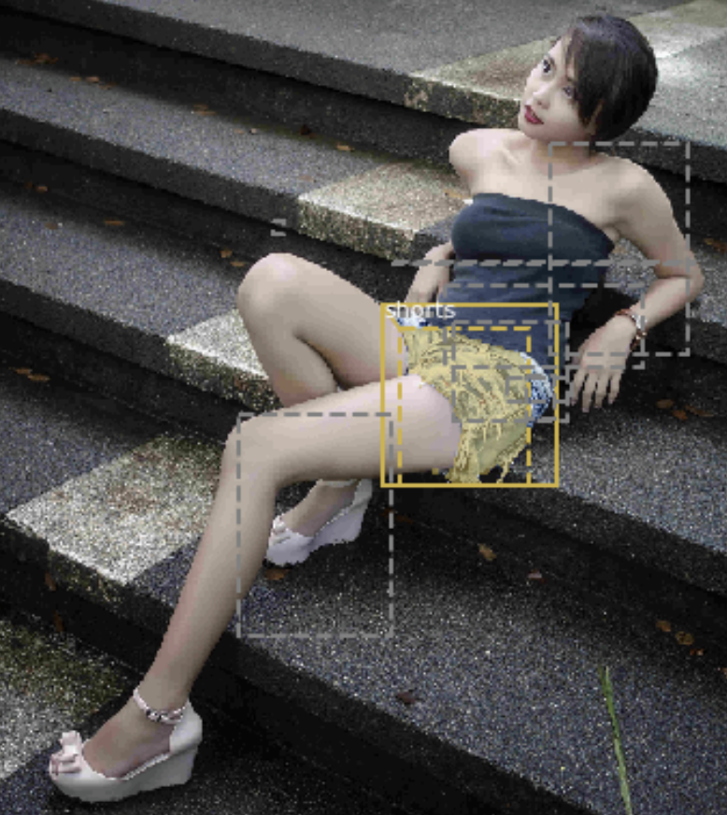
Mask R-CNN – ROI Align – Refined Selections
RPN Results
Faster R-CNN
Object Detection Branch
Segmentation Branch
Mask R-CNN
ROI Alignment
REMOVE
Selected regions aligned to same size before feeding into final layer

Slide 13
Mask R-CNN – ROI Align – Refined Selections
Faster R-CNN
Mask R-CNN Output
Classification
Bounding Box
Segmentation Mask
Object Detection Branch
Segmentation Branch
Mask R-CNN
Top scoring regions sent to:
object detection branch (Faster R-CNN)
segmentation branch (Mask R-CNN).
3 network outputs (class, box, mask)
Segmentation processed in parallel to classification

Slide 14
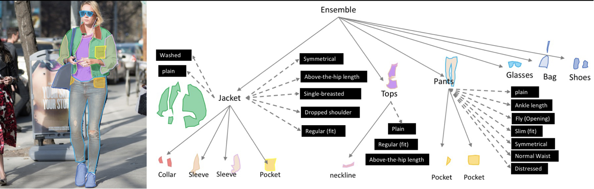
Fashion Segmentation – Experimentation with Mask RCNN
2019 Fashion Kaggle Competition
Dataset of 45k images and 300k annotations
Labels include fine details of clothing items in 46 classes
https://www.kaggle.com/c/imaterialist-fashion-2019-FGVC6/overview

Slide 15
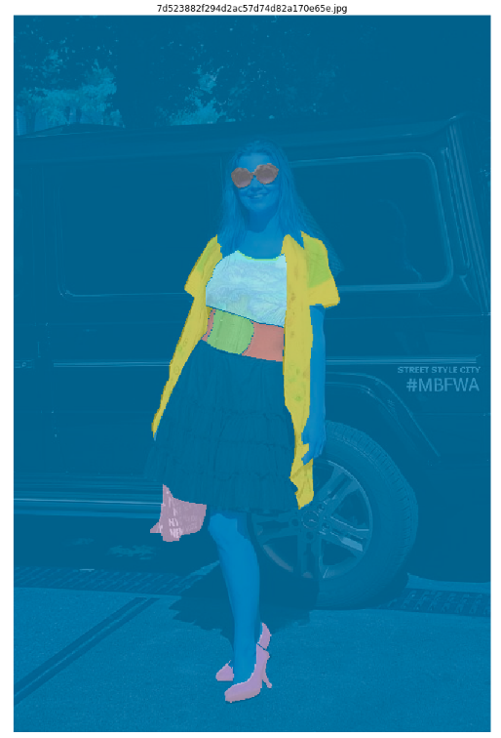
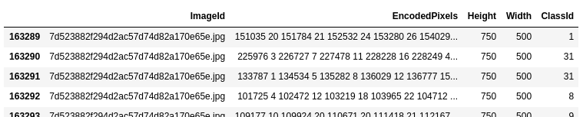
iMaterialist Dataset
Exploratory Data Analysis
Kaggle Data
Matterport Mask-RCNN
Keras/Tensorflow
Images
Train CSV
DataSet
Train
Classes CSV
Dataset of ~45K images with total of ~300k annotations
Annotations provided in Run-Length Encoding(RLE) Format
The ClassId is obtained by concatenating both predicted apparel object index
and predicted attributes' indices for this object.
e.g 6_28_77 → Category: Pants ; Attributes: Bell, Leopard
Fine-grained attributes were ignored for this project
Figure: (L) Sample dataframe from iMaterialist Dataset , (R) Corresponding image with decoded annotation masks

Slide 16
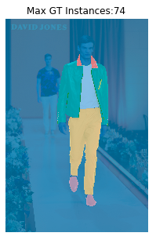
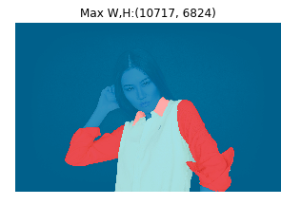
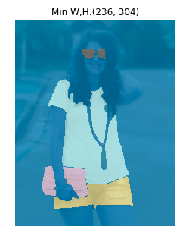
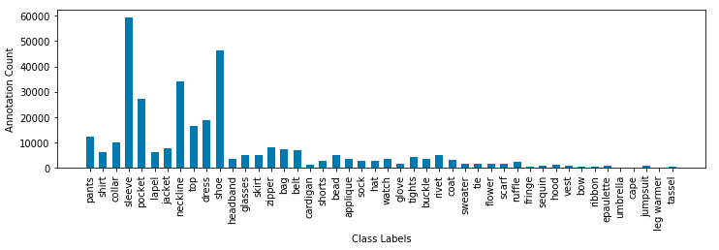
iMaterialist Dataset
Dataset in numbers
Training Images | 45625
Test Images | 3200
Training Annotations (GT) | 333415
Max GT Instance/ Image | 74
Mean GT Instance/Image | 7.3
Max Dimensions (W,H) | (10717,6824)
Min Dimensions (W,H) | (236, 304)
Categories | 46
Max Category Count | 59452 (sleeve)
Min Category Count | 112 (leg warmer)
Median Category Count | 3212
Figure: Sample images from iMaterialist Dataset with extremas
Figure: Distribution of annotation masks in dataset by categgory

Slide 17

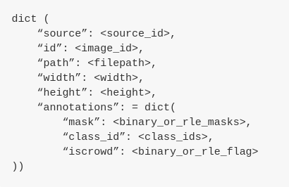
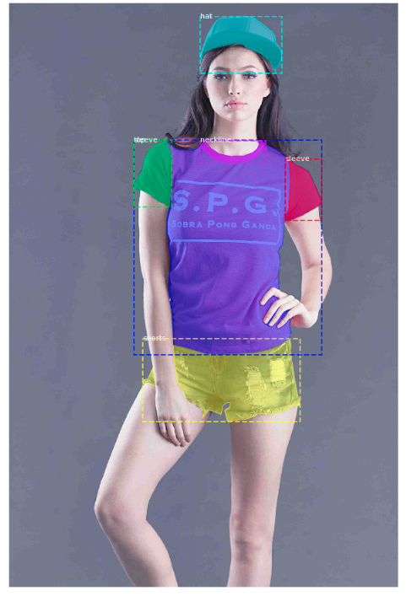
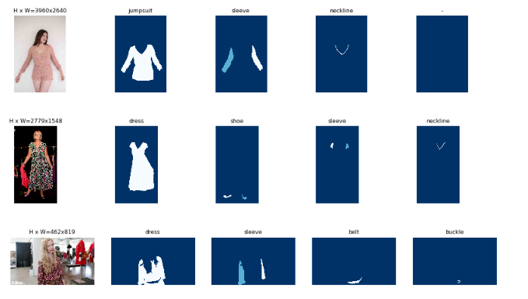
Fashion Segmentation
Matterport Mask RCNN Implementation
Kaggle Data
Matterport Mask-RCNN
Keras/Tensorflow
Images
Train CSV
DataSet
Train
Classes CSV
Mask-RCNN Matterport implementation
Provides COCO-style Dataset structure to import the custom data
Dataset class used for image handling and training in Keras
Sample images with mask instances after loading into COCO-style dataset
https://www.kaggle.com/c/imaterialist-fashion-2019-FGVC6/overview

Slide 18
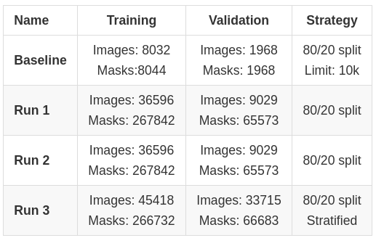
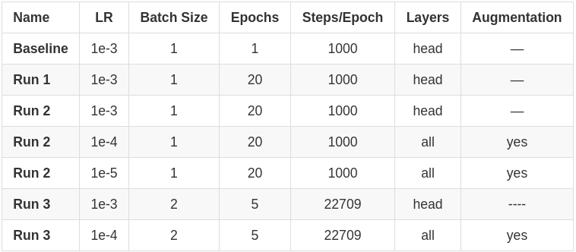
Fashion Segmentation
Training Summary
Kaggle Data
Matterport Mask-RCNN
Keras/Tensorflow
Images
Train CSV
DataSet
Train
Classes CSV
Dataset Usage: 80/20 split
Hyper-parameters Tuning
SGD Optimizer with variable learning rate
NVIDIA GPU GTX 1070

Slide 19
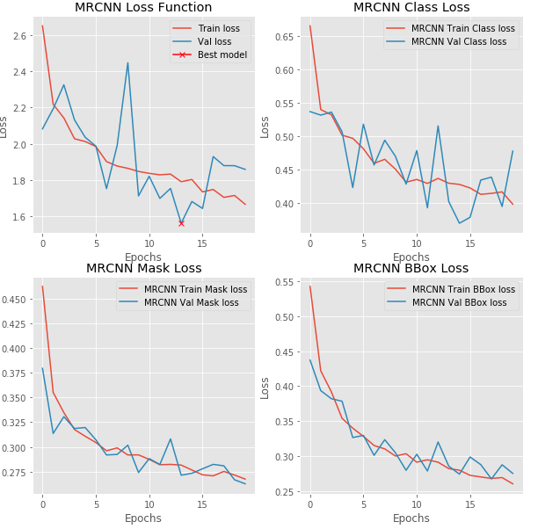
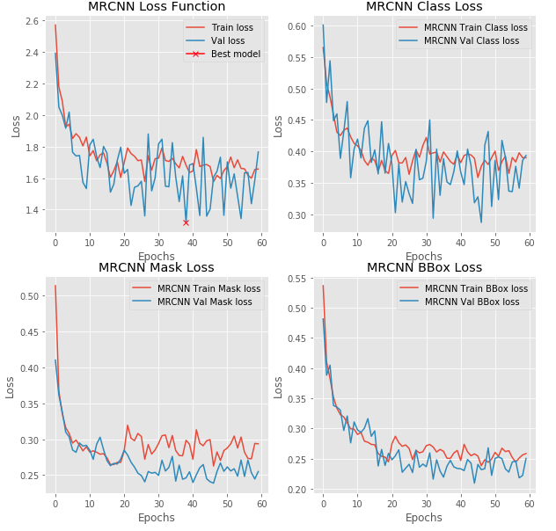
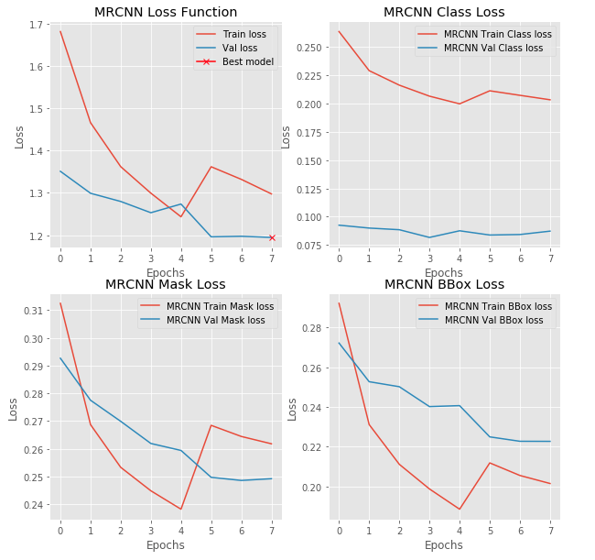
Fashion Segmentation
Training Losses
Kaggle Data
Matterport Mask-RCNN
Keras/Tensorflow
Images
Train CSV
DataSet
Train
Classes CSV
Run 1
Run 2
Run 3

Slide 20
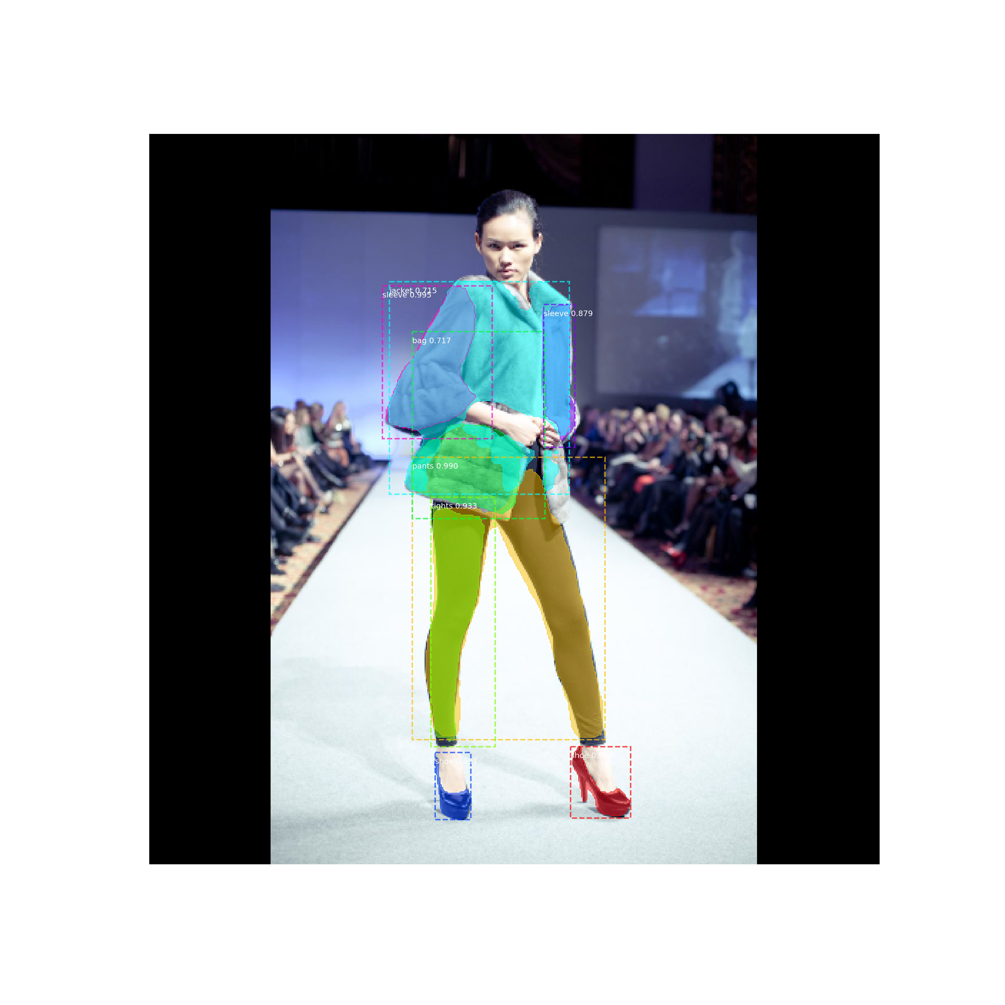
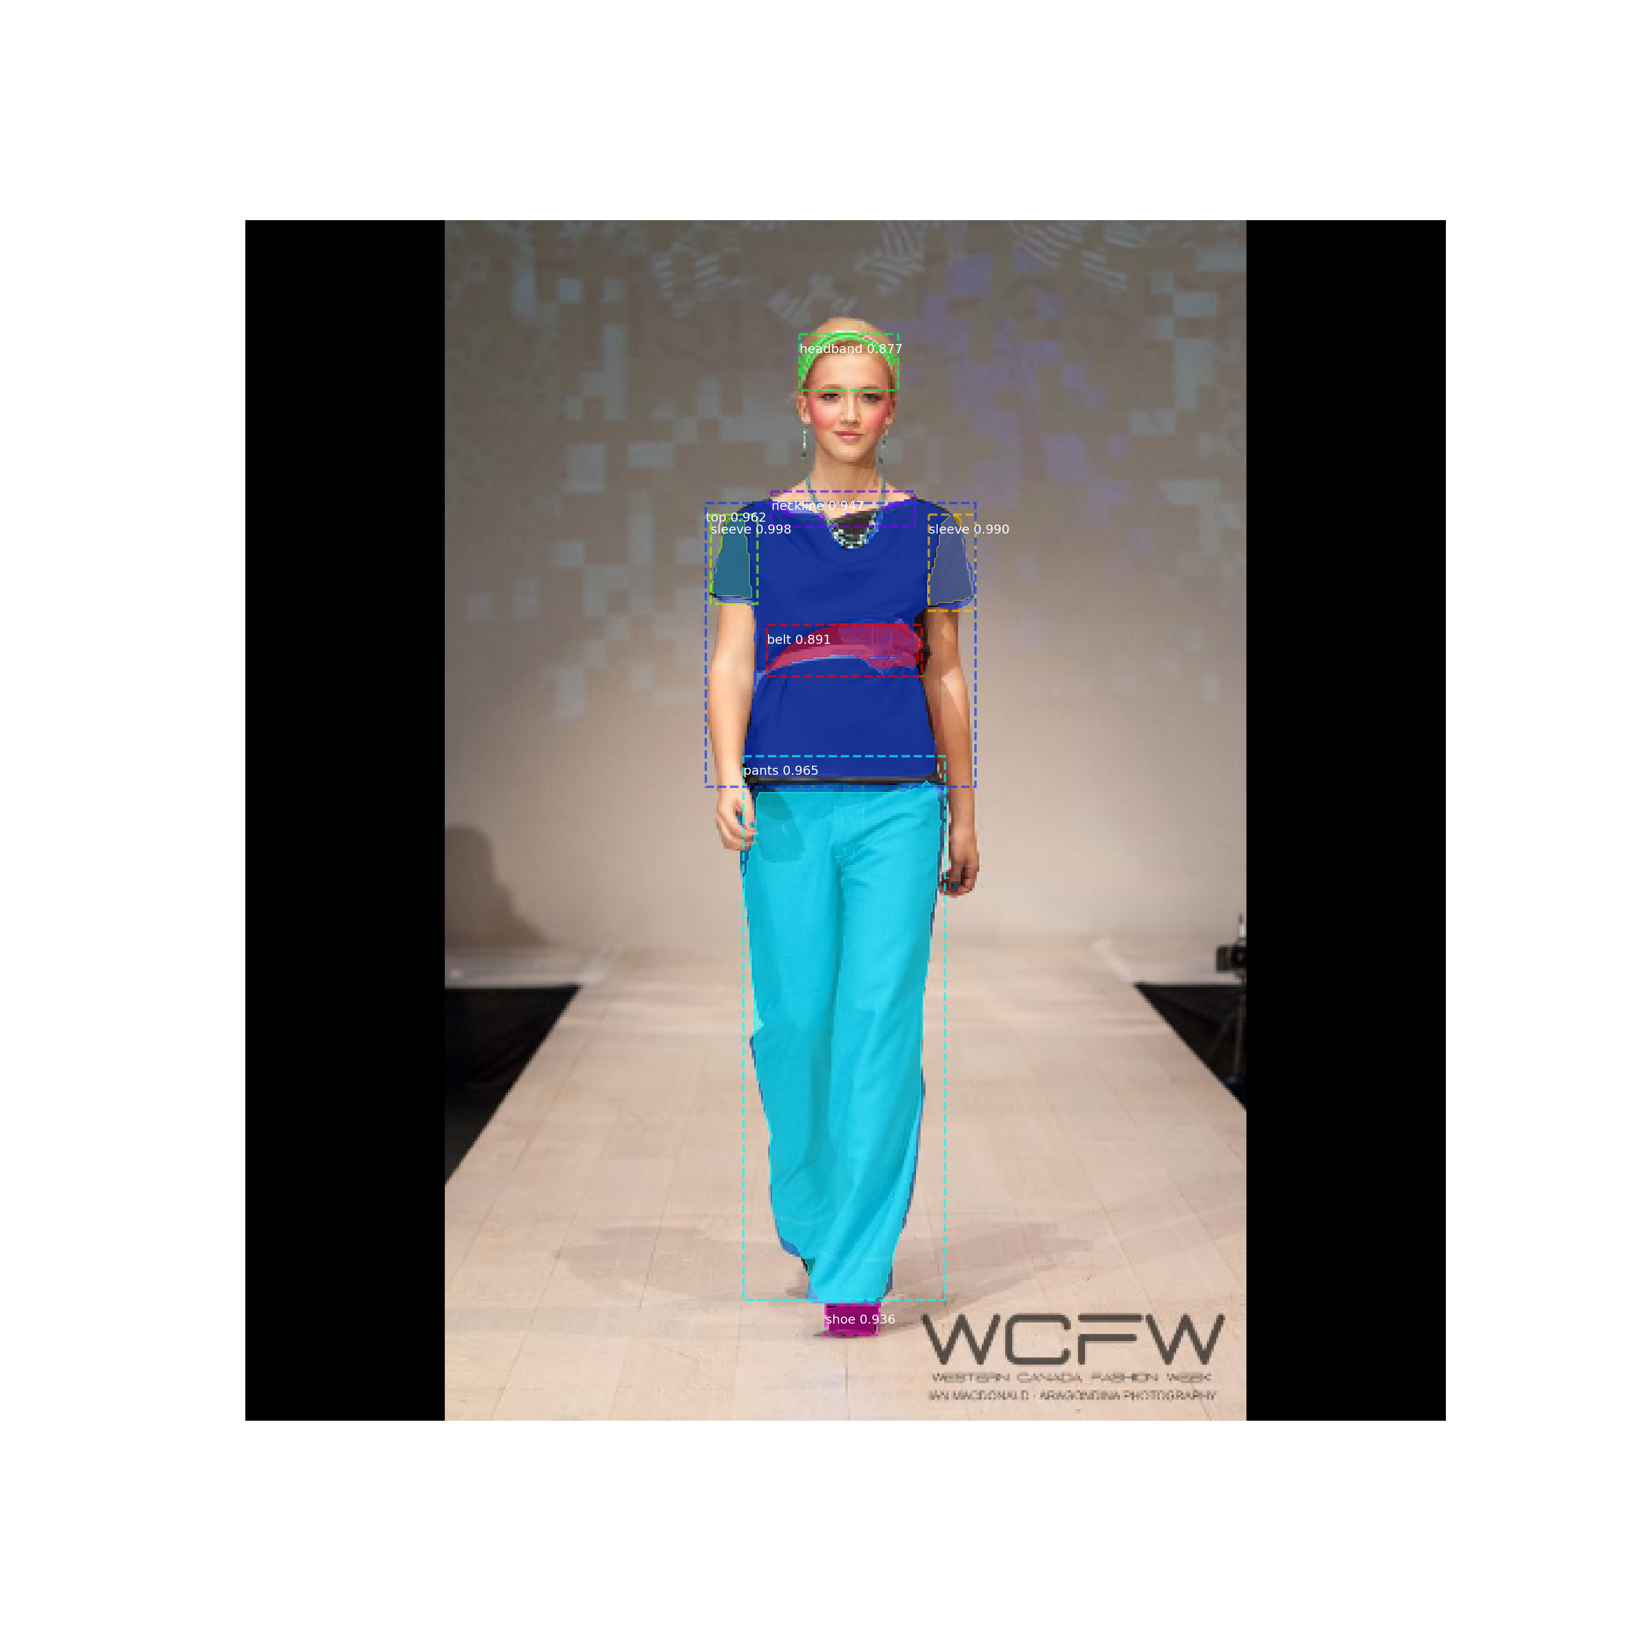
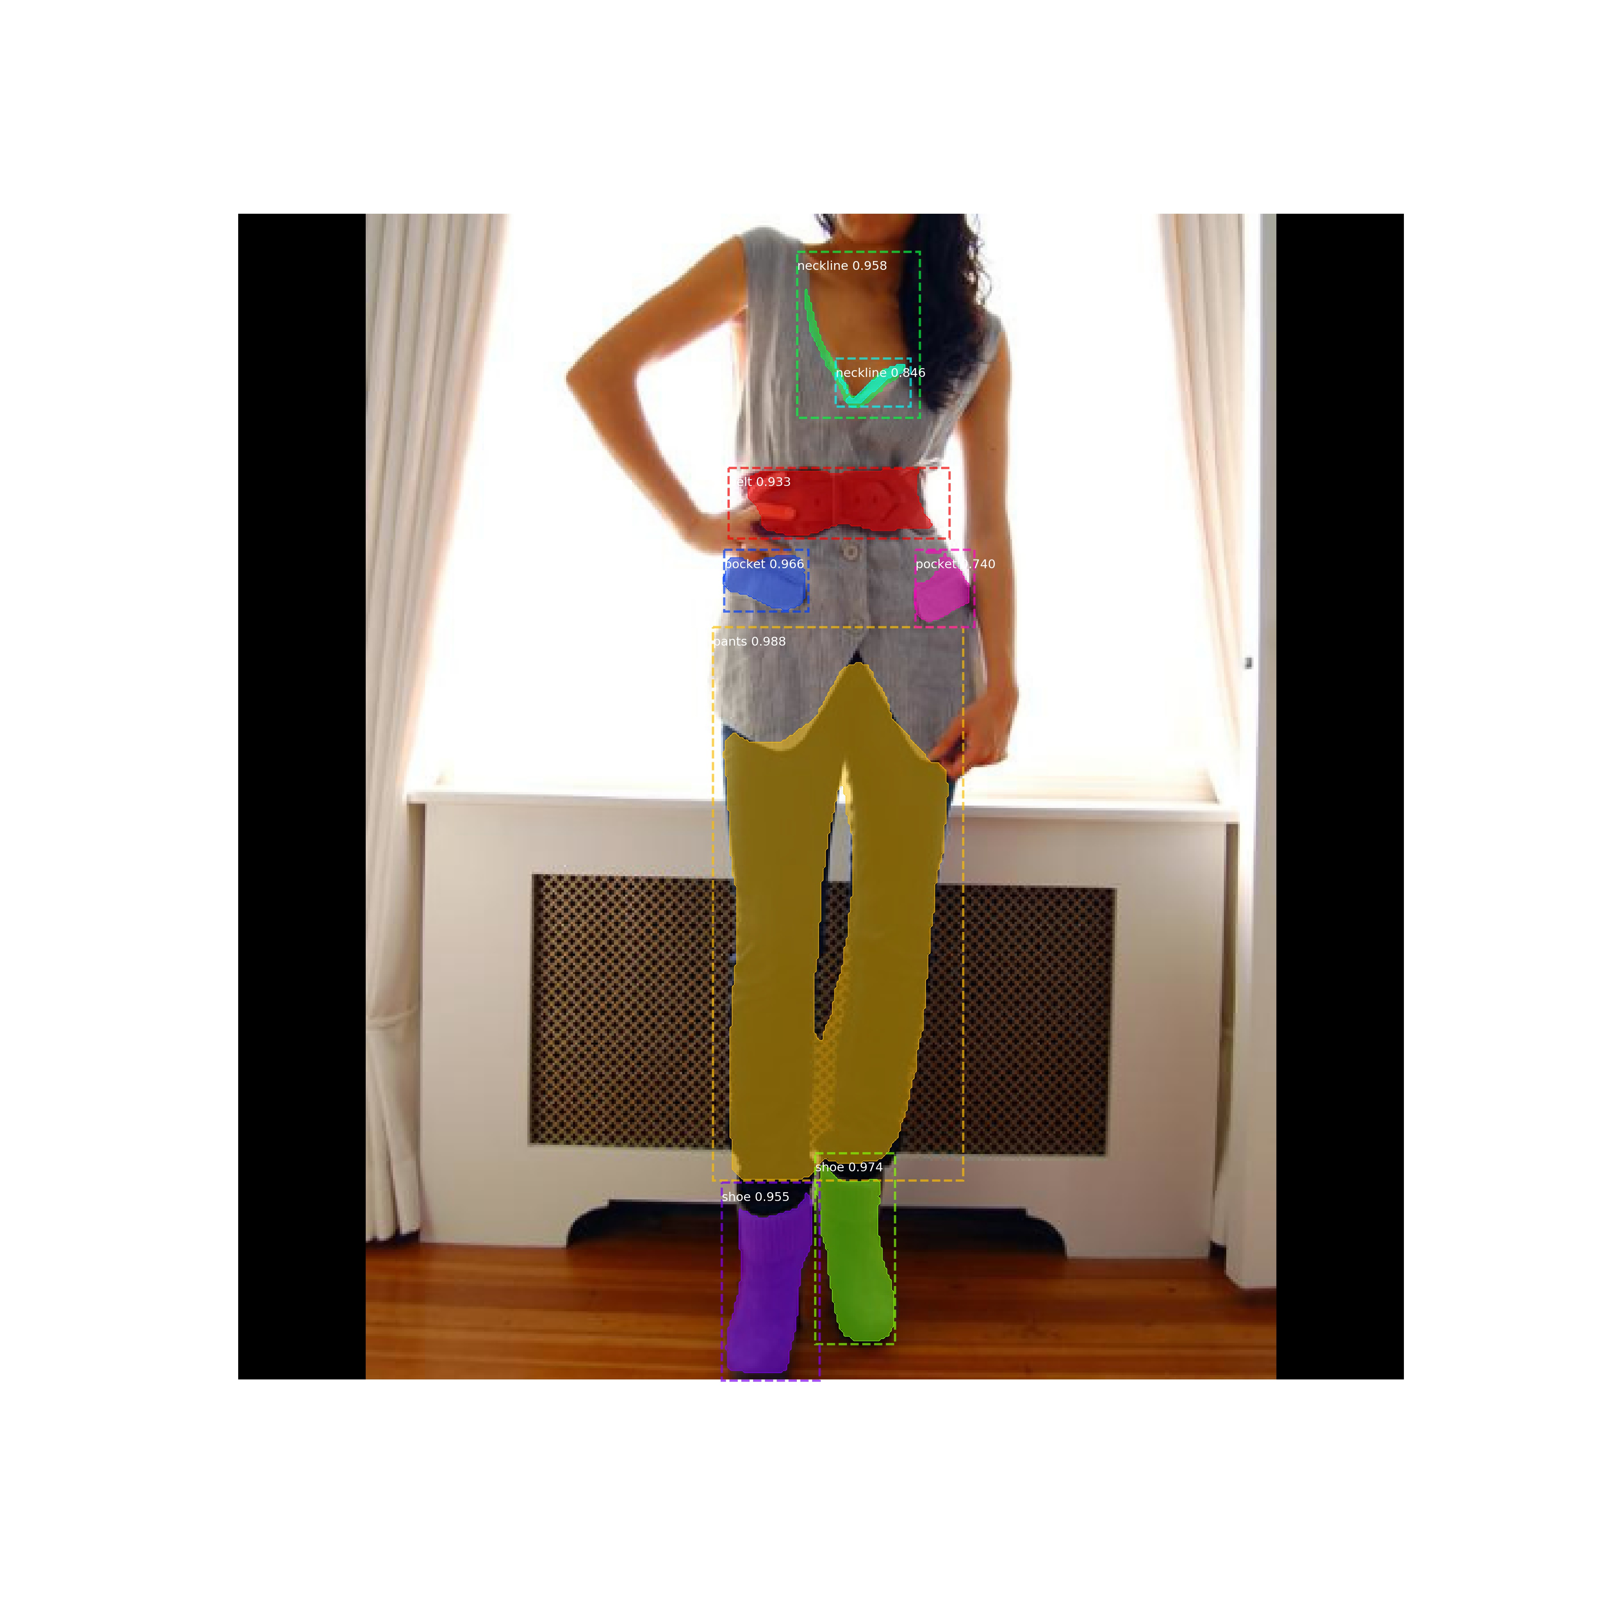
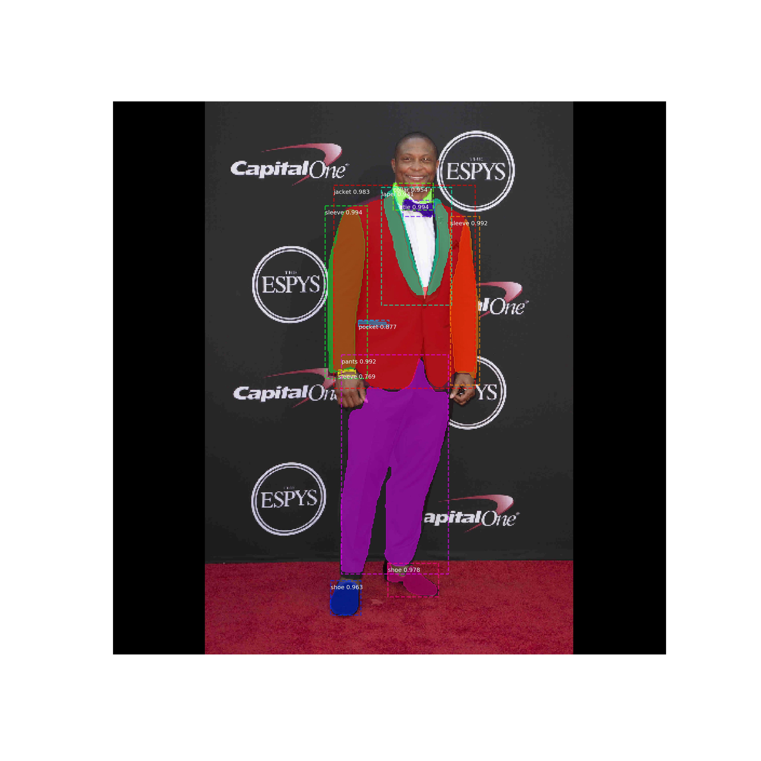
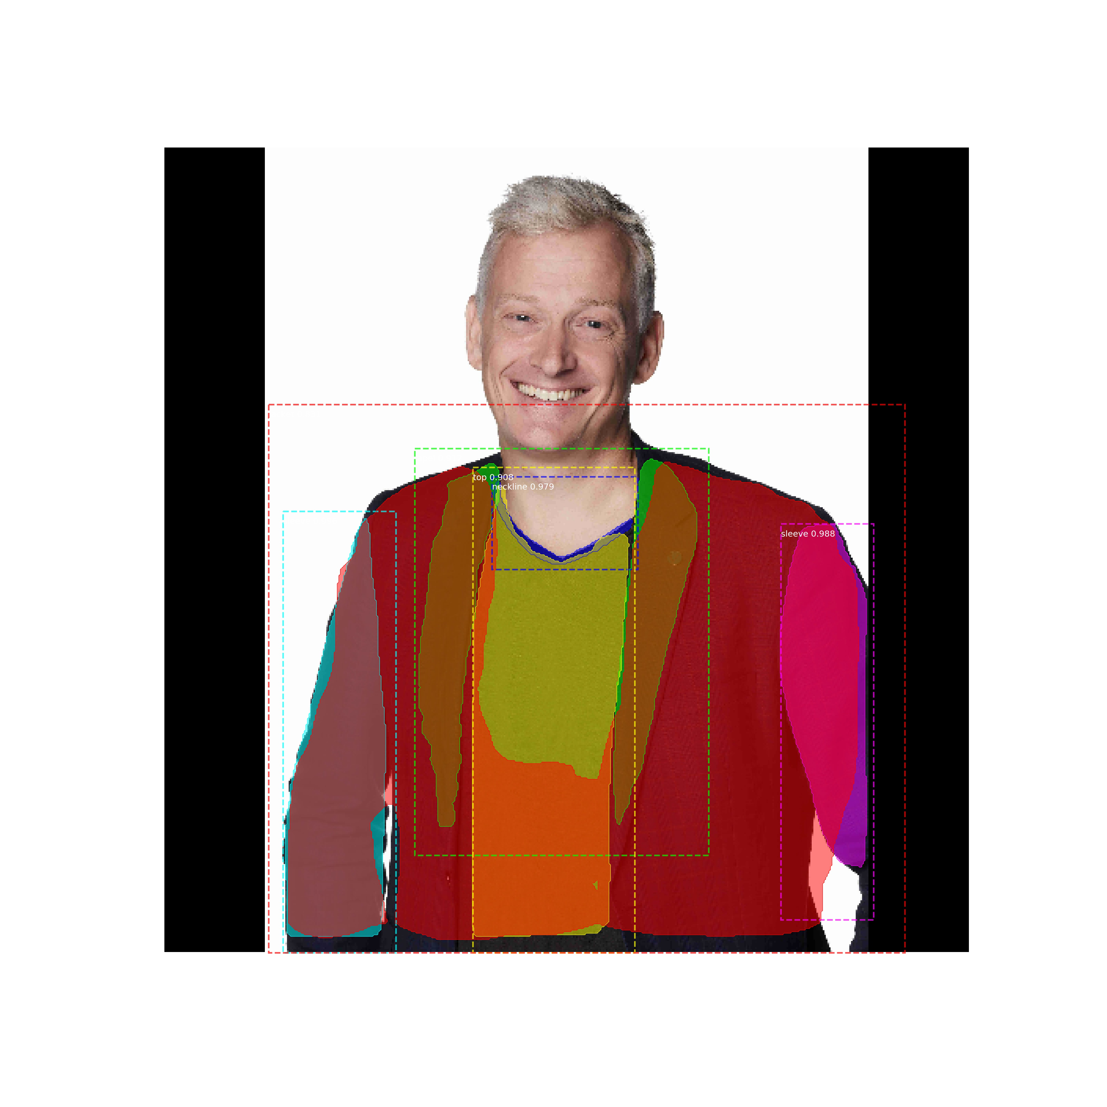
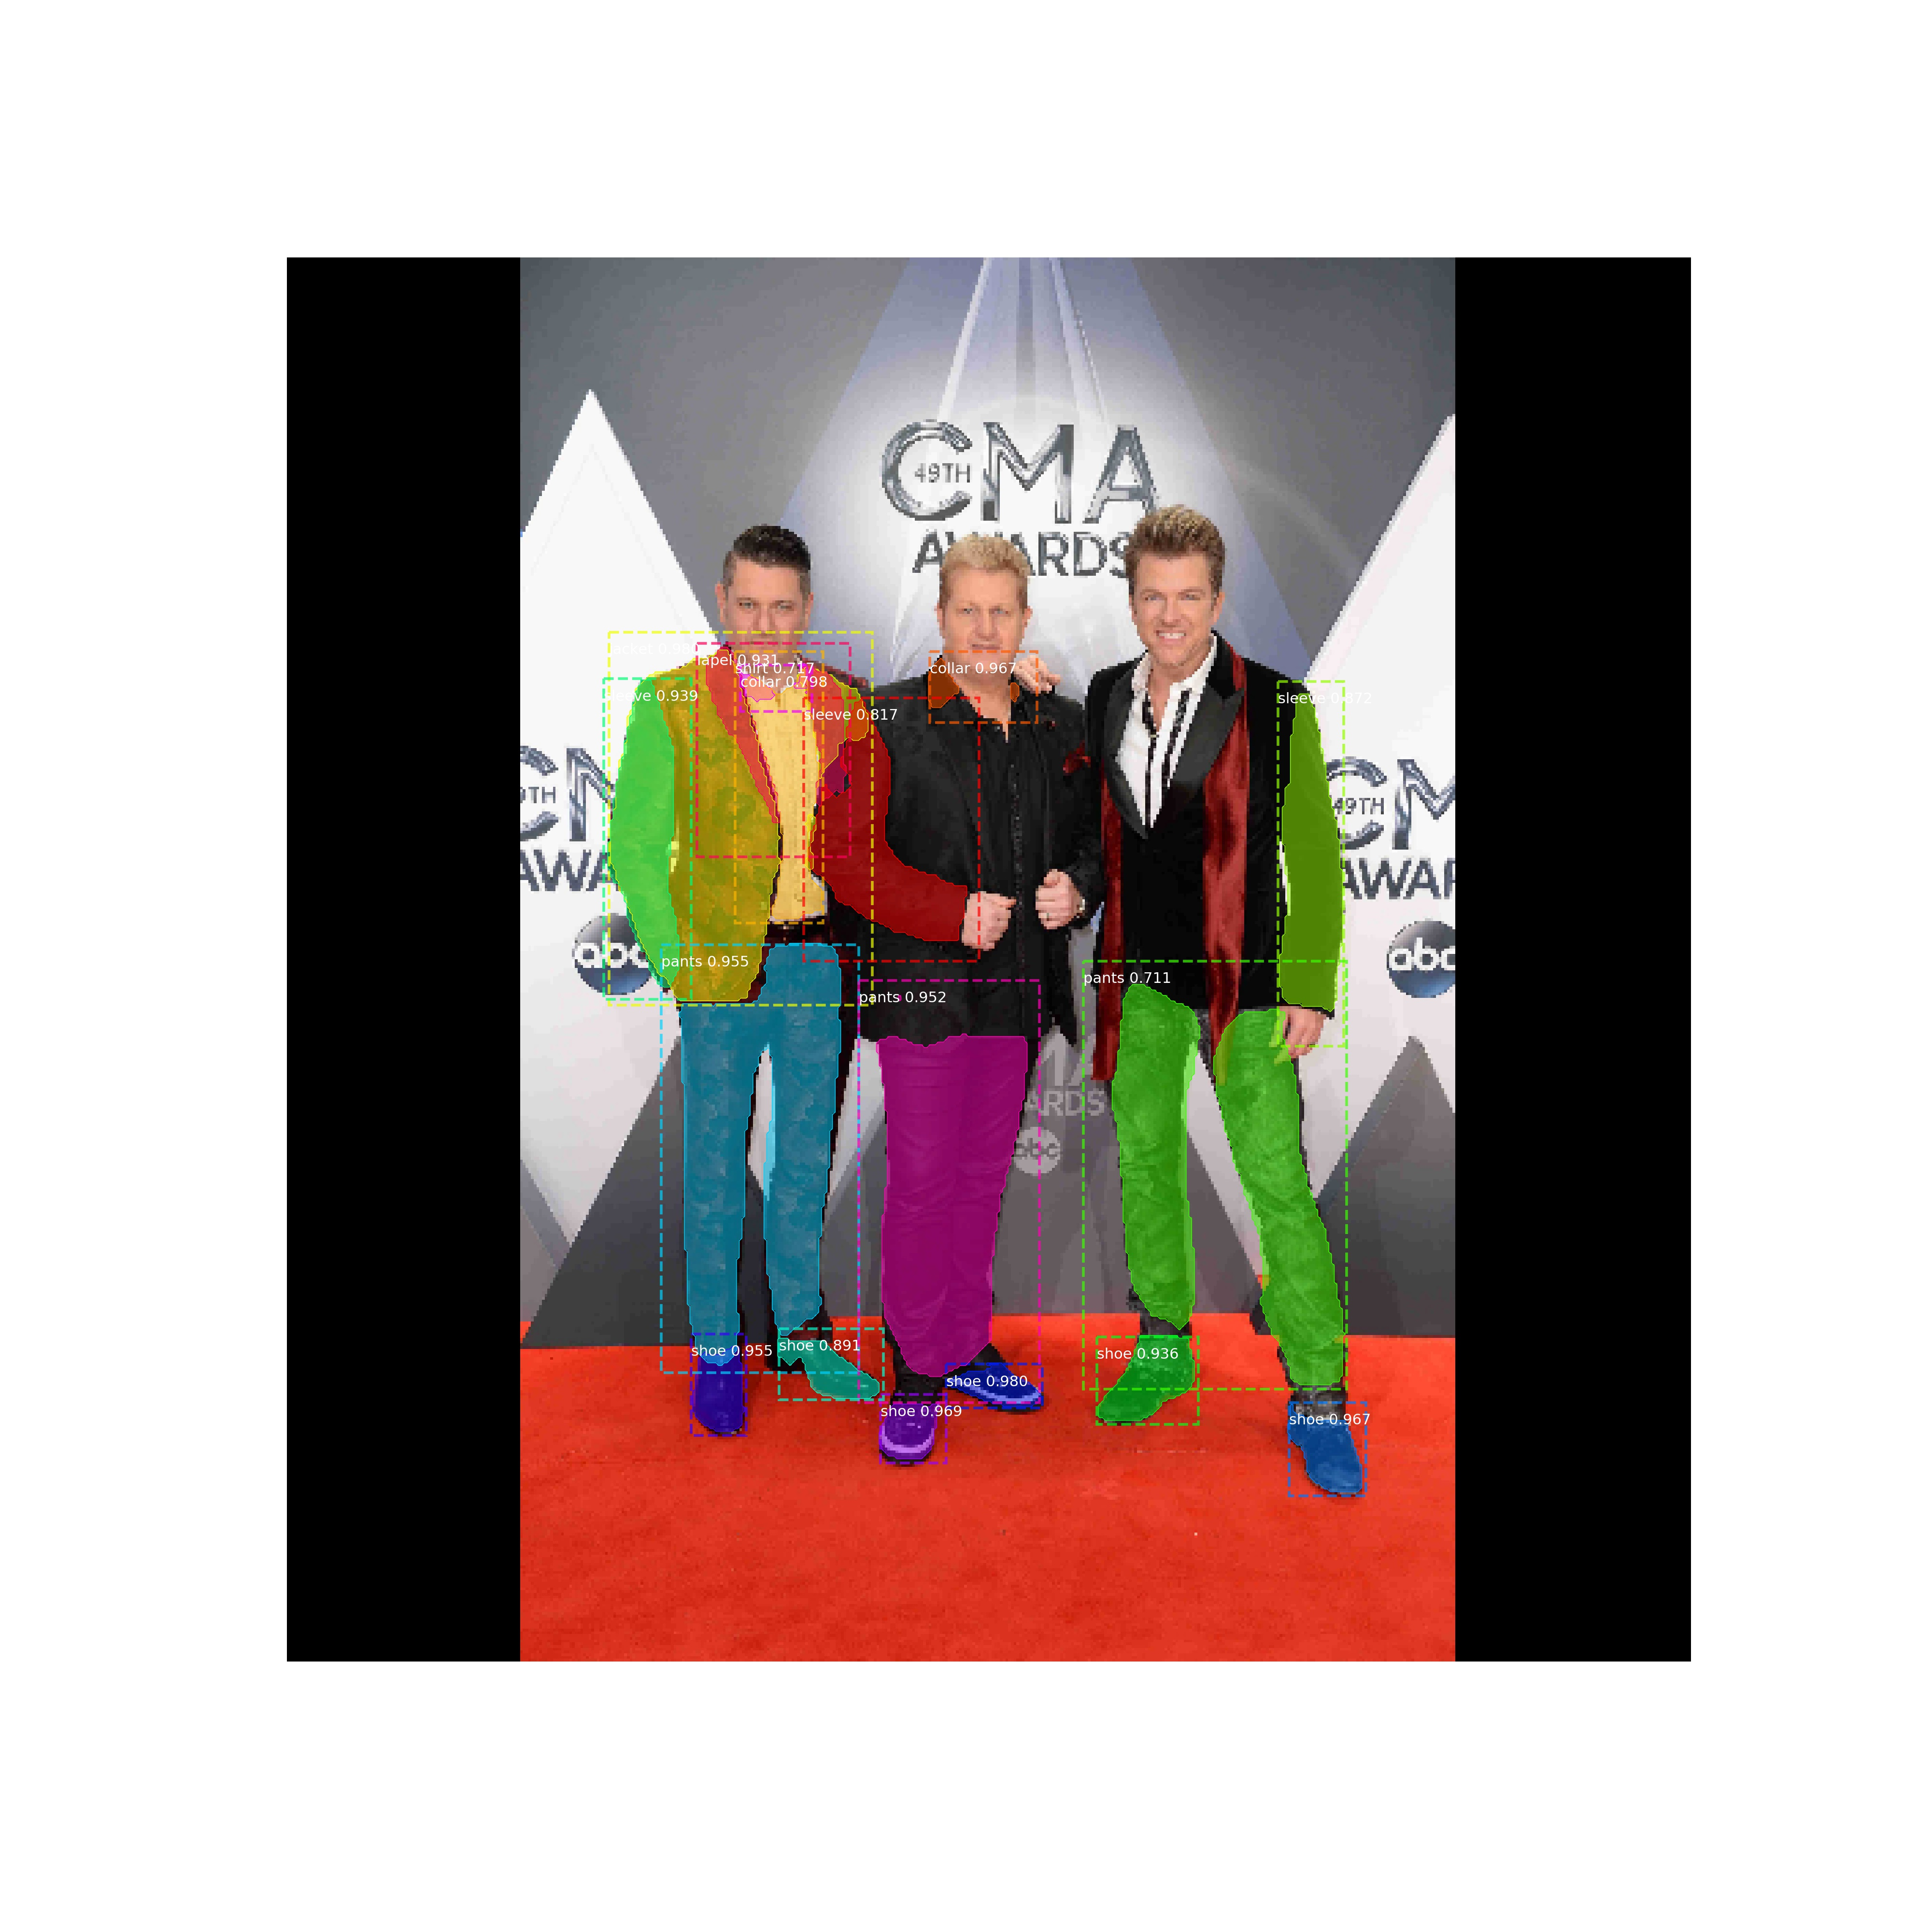
Fashion Segmentation
Results

Slide 21
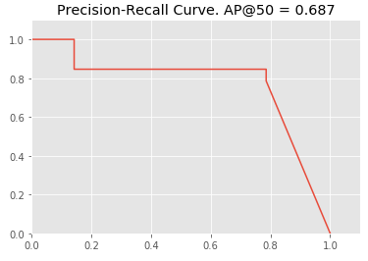
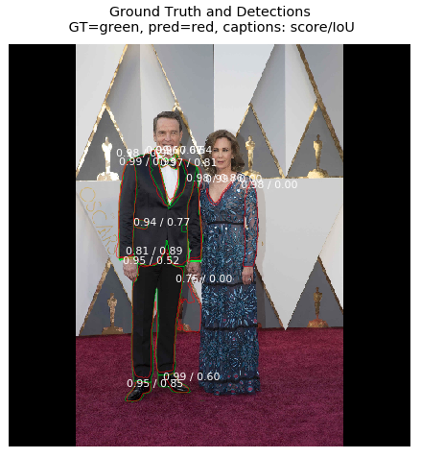
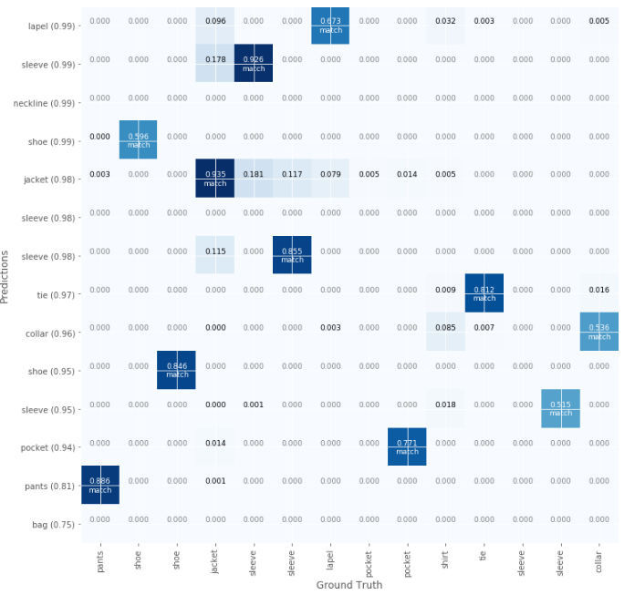
Fashion Segmentation
Results
Figure : Precision-Recall Curve
Sample Image with ground truth and predictions, and scores
Figure : Confusion Matrix

Slide 22
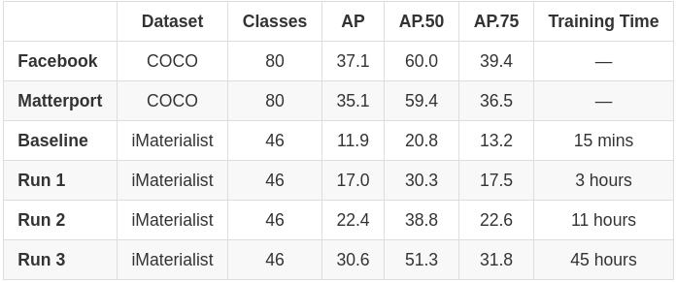
Fashion Segmentation
Evaluation Metrics
IoU(A,B)= A∩B / A∪B
AP calculated over range from 0.5 to 0.95 with a step size of 0.05: (0.5, 0.55, 0.6, 0.65, 0.7, 0.75, 0.8, 0.85, 0.9, 0.95)
Reported numbers for our model are mean Average Precision values (mAP) over a batch of 100 random images from validation dataset
Average Precision values improve with training the model over the entire dataset

Slide 23
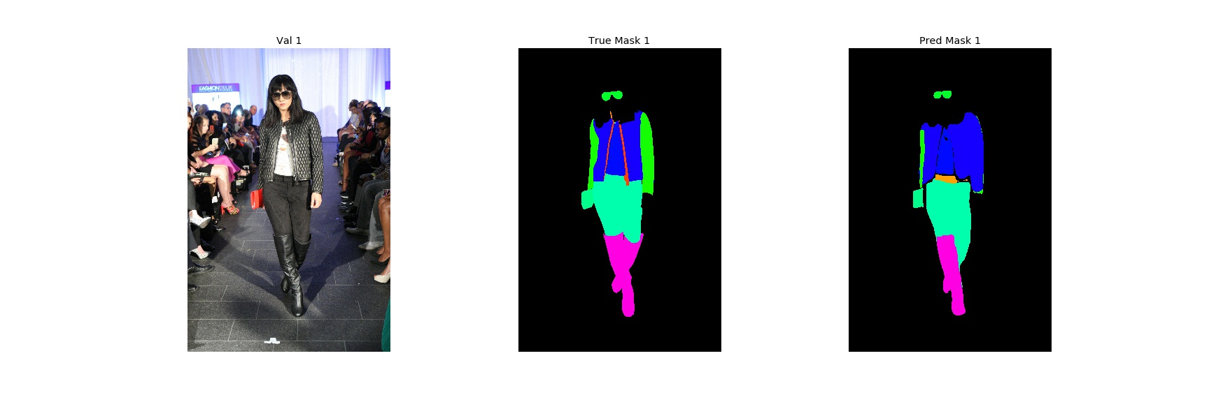
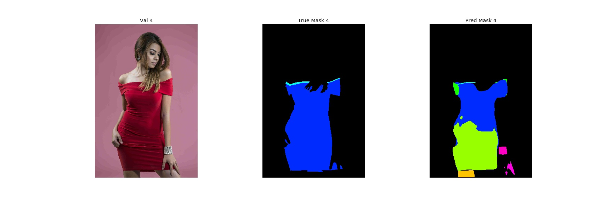
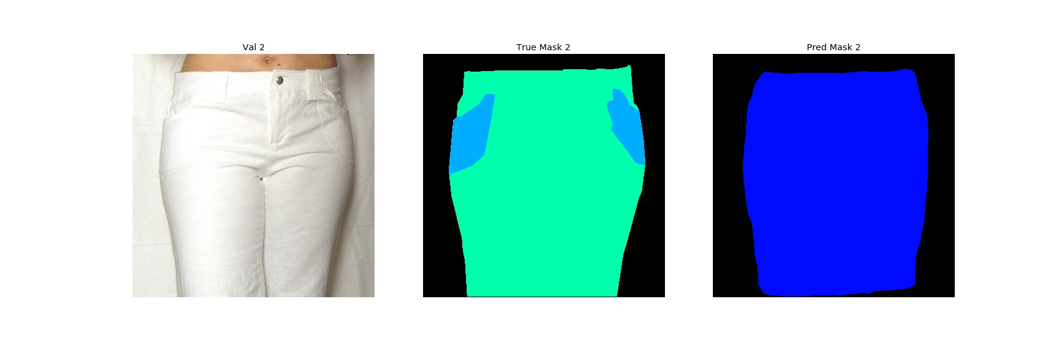
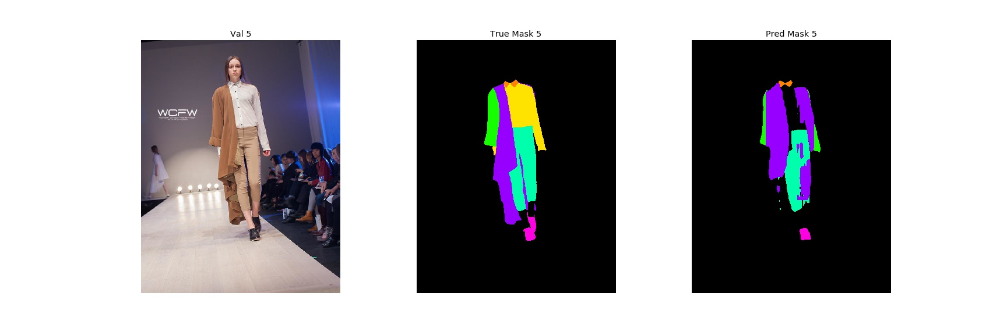
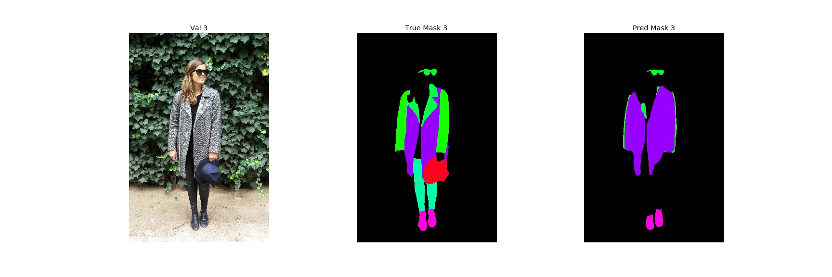
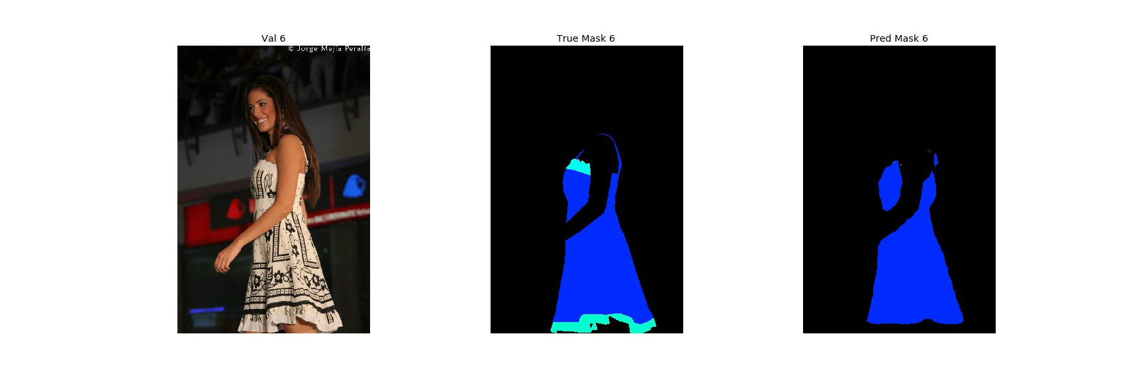
Fashion Segmentation
Predictions as semantic masks

Slide 24
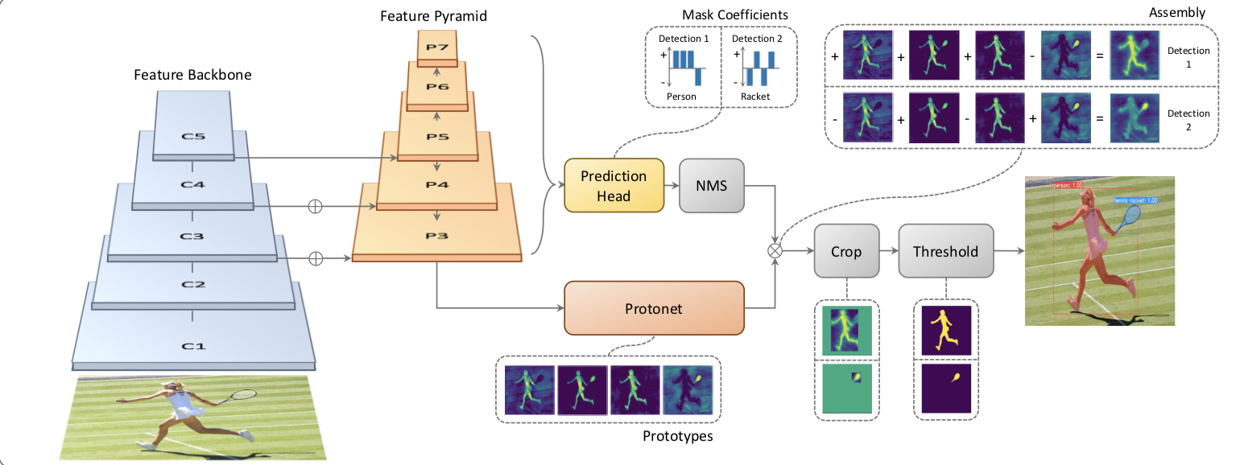
YOLACT (You Only Look At CoefficienTs)
Real-time speeds
Learns a “prototype” mask for a dataset.
Image values determine coefficients applied to prototype mask
Focus on speed, not accuracy
http://openaccess.thecvf.com/content_ICCV_2019/papers/Bolya_YOLACT_Real-Time_Instance_Segmentation_ICCV_2019_paper.pdf

Slide 25
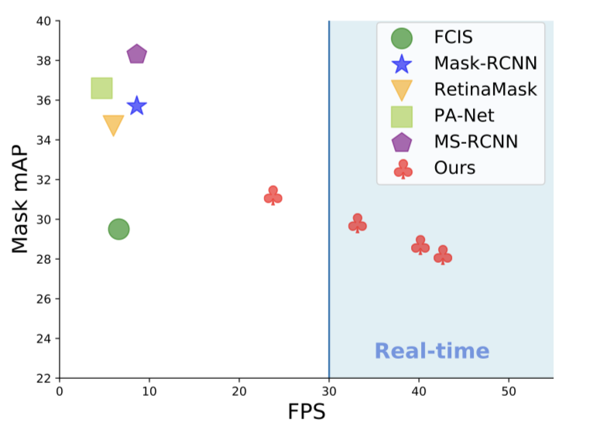
YOLACT (You Only Look At CoefficienTs)
Remarkable speed increase!
Mask RCNN
Employs new approach to masking
Learns coefficients of a transformation rather than mask
Transforms a ‘prototype’ mask into a segmentation with the coefficients.
YOLACT
YOLACT

Slide 26
Mask R-CNN – Improvements
Design process so that training doesn’t converge so quickly:
Effective use of augmentation
Regularization
Try impact of using other backbone networks (ResNet101, 152, VGG, etc.)

Slide 27
Mask R-CNN – Conclusion
As Mask R-CNN is an ‘add-on’ to a classification model (Faster R-CNN), it is very likely we will see a bottom up segmentation architecture that addresses speed and accuracy.
Segmentation training can be time consuming. Even with sufficient resources, training times are measured in days.
Published inference times are 5fps, but our experience was more like 5 seconds per frame.
Understanding how to efficiently format data and code for resource utilization are valuable skills.
We may have gotten lucky by choosing a solid implementation of Mask R-CNN.
YOLACT has promise but implementation is complex.
Attempts to build and train our own network were only partially successful even after days of training.

Slide 28
BACKUP

Slide 29
Resolution
Semantic Meaning
Encoding
`

Slide 30
Encoding
`

Slide 31

Pyramid Structure – Pre-Trained Encoder
Major benefit of Encoder Structure
Pre-Trained Encoder
Plugs into a decoder.
Avoids training from scratch.
Decoder
Trained on specific dataset.
Encoder can still share features from various scales. Decoder design must take encoder dimensions into account.
e.g.
ResNet101
Encoding

Slide 32
Encoder Architecture
Most segmentation models use an encoder structure
Details shared during decoding
Input:
image
Output: Mask
Encoding
Encoder
Decoder
Modularity:
A benefit of this structure is that the encoder and decoder portions can be separated.

Slide 33
Encoder Architecture
Most segmentation models use an encoder structure
Input:
image
Pre-Trained Network
Output: Mask
Encoding
Encoder
Decoder
Pre-Trained Networks:
ResNet, VGG, …

Slide 34
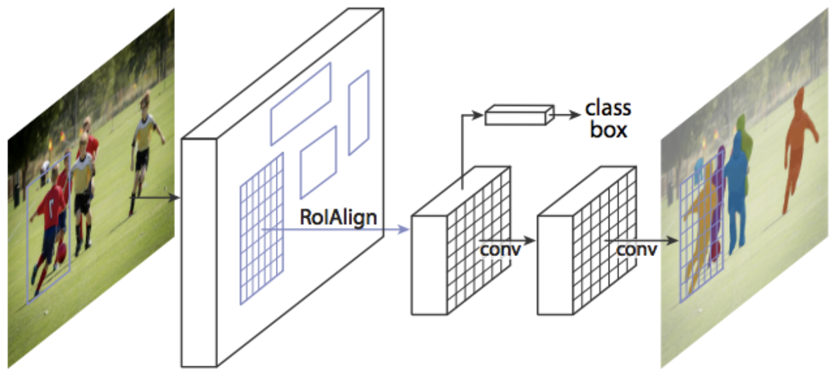
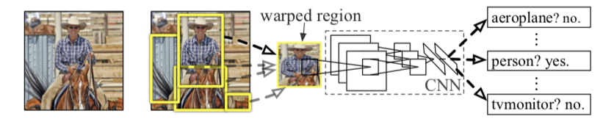
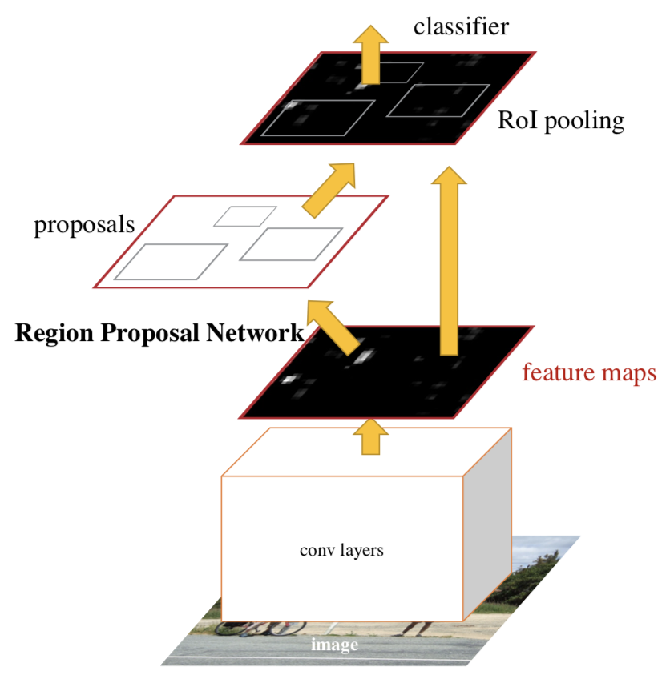
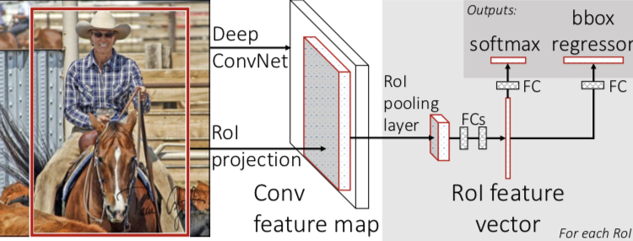
Mask R-CNN - Evolution
Introduced concept of region proposals
Adds Instance Segmentation
3 outputs:
Classification
Bounding Box
Instance Segmentation
(near real-time 5fps)
Single network for features, classification and bounding boxes
Added Region Proposal Network
(near real-time 5fps)
PASCAL VOC (R-CNN)
54%
66%
78%
Oct 2014
R-CNN
Sep 2015
Fast R-CNN
Jan 2016
Faster R-CNN
Jan 2018
Mask R-CNN
https://arxiv.org/pdf/1311.2524.pdf
https://arxiv.org/pdf/1504.08083.pdf
https://arxiv.org/pdf/1506.01497.pdf
https://arxiv.org/pdf/1703.06870.pdf
https://blog.athelas.com/a-brief-history-of-cnns-in-image-segmentation-from-r-cnn-to-mask-r-cnn-34ea83205de4

Slide 35
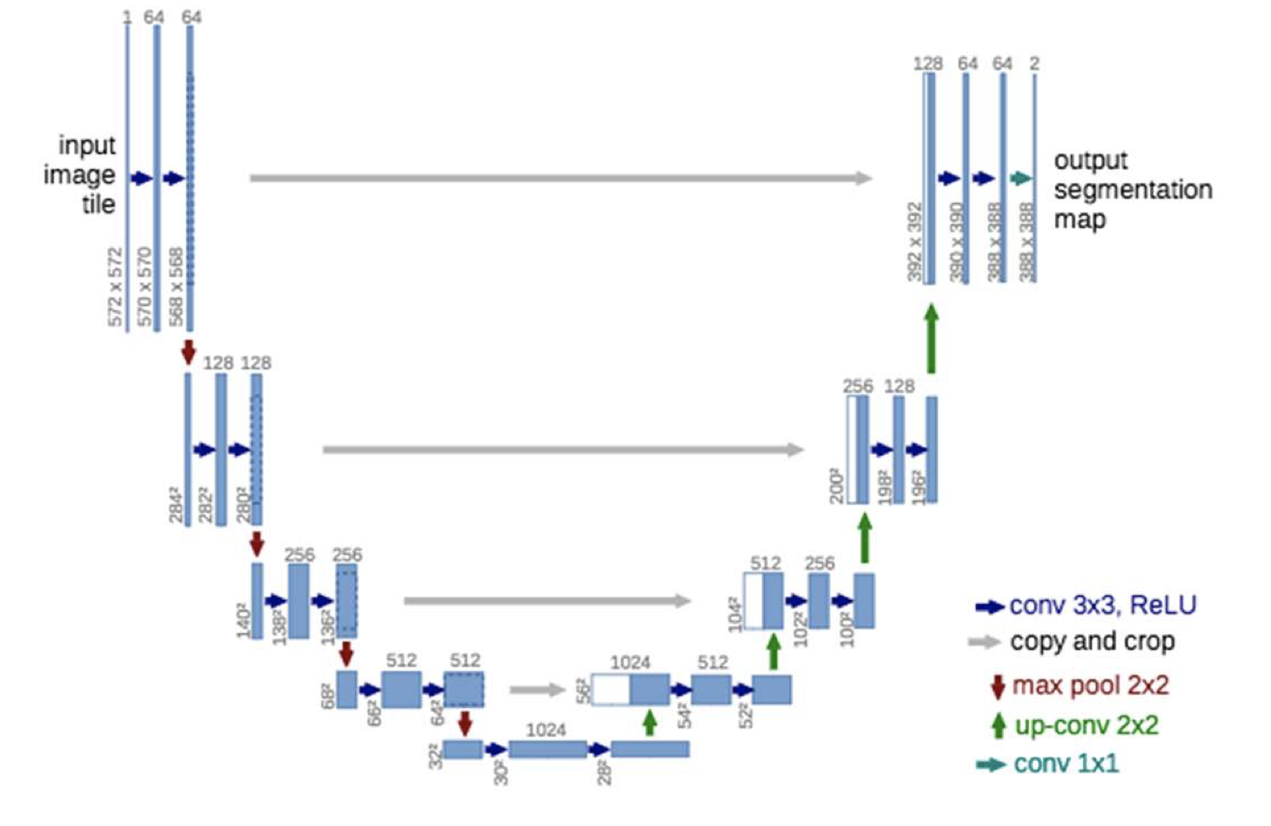
Encoder Modularity Example
Build Steps:
Isolate Unet decoder
Import Resnet pretrained network
Connect Layers
Adjust Image scaling for training
Train
Adjust image scaling for inference
ResNet
Unet
Input
Block 1
Block 2
Block 3
Block 4
Block 5
Encoder

Slide 36
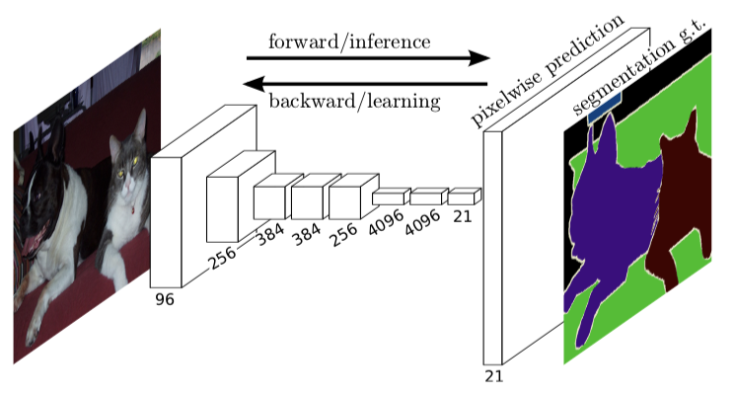
FCN (Fully Convolutional Network)
Early segmentation architecture
Uses CNN’s throughout
https://arxiv.org/pdf/1605.06211v1.pdf

Slide 37
UNet
Uses skip connections to maintain detail in decoder
Used in medical imaging where detail is important
https://arxiv.org/pdf/1505.04597.pdf

Slide 38


Mask R-CNN
Iteration of R-CNN evolution
Adds segmentation to previous iterations
Includes bounding boxes and instance segmentation
https://medium.com/@jonathan_hui/image-segmentation-with-mask-r-cnn-ebe6d793272
https://arxiv.org/pdf/1703.06870.pdf

Slide 39

PSPNet (Pyramid Scene Parsing Network)
Detects objects of varying size using Pyramid of convolutions
Classifies based on overall image context
A single PSPNet yields the new record of mIoU accuracy 85.4% on PASCAL VOC 2012 and accuracy 80.2% on Cityscapes.
https://arxiv.org/pdf/1612.01105.pdf

